Slide 1
Walmart Class Rental Fund
$3,000,000 fund that will only acquire performing properties that meet a 30% gross yield
Yield paid monthly to investor
Depreciation benefits
Upside appreciation potential
Sample properties next page

Slide 2
What is a Walmart class rental?
We use several indicators to help us determine areas that we deem as “Walmart class”
www.ZipSkinny.com
This website provides you with hundreds of data points on any given zip code
We pay attention specifically to
Unemployed (we like to see less than 5%)
Percentage Below Poverty Level (we like to see less than 15%)
Walmart
We do not go into markets that do not have a Walmart within 10 miles
Walmart will make sure there is economic activity in an area, so, we piggy-back off of their market research

Slide 3
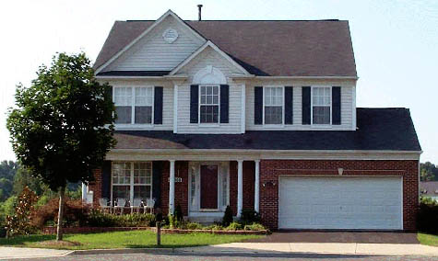
What is NOT a Walmart class rental?
While we would all love for our rent houses to look like this AND they meet the ZipSkinny and Walmart criteria, they can not be purchased at a price that gives any level of significant ROI
Example Zipcode: 75025
1.9% Unemployed
2.3% Below Poverty Line
Purchase price - $130,000
Rent $1200 – Gross yield- 11% -- tough to manage and make any money

Slide 4
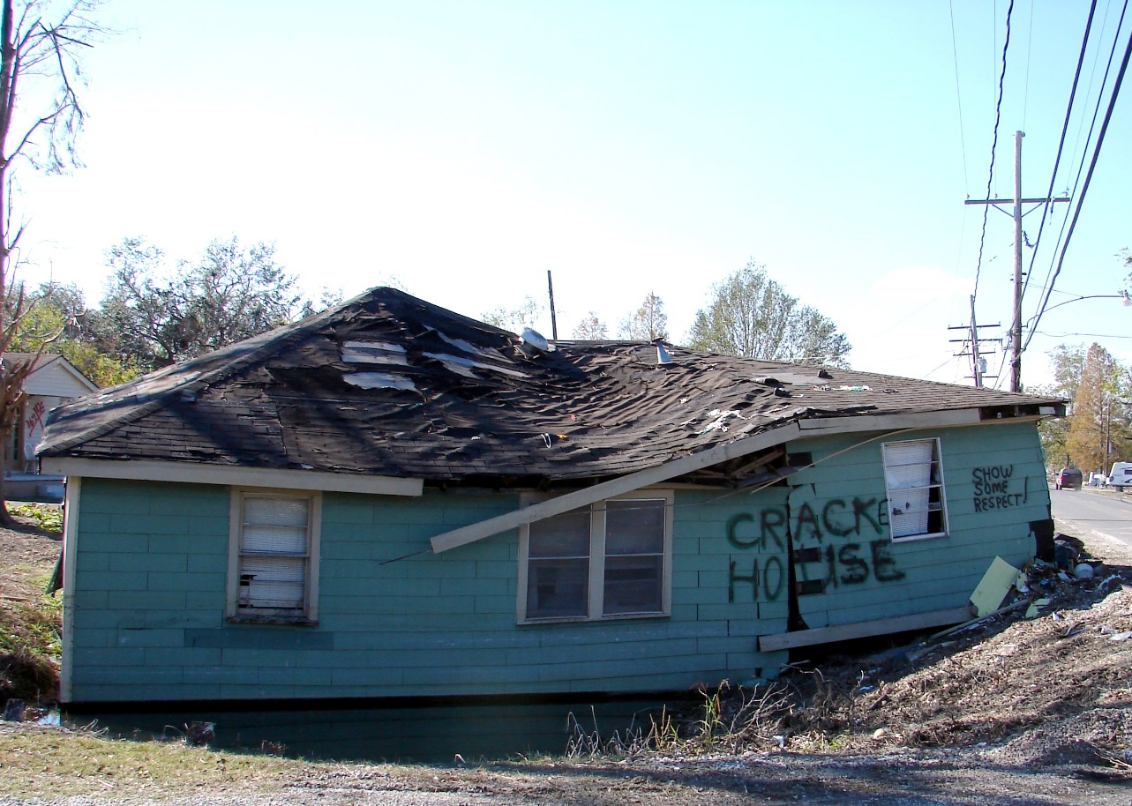
What is NOT a Walmart class rental?
While many homes can be purchased cheaply, they DO NOT meet the ZipSkinny and Walmart criteria.
Example zipcode: 75215
11% Unemployed
44% Below Poverty Line

Slide 5
Example Properties
The following are a few properties that fall into the criteria we are looking for
They are in neighborhoods where the typical salary is just over minimum wage and the rent is still affordable
They are clean, tidy and totally functional
The tenants have an office cell phone number to call or text repair issues that are then logged and tracked
The tenants deposit their rent into Walmart bank accounts and have a receipt for their records

Slide 6
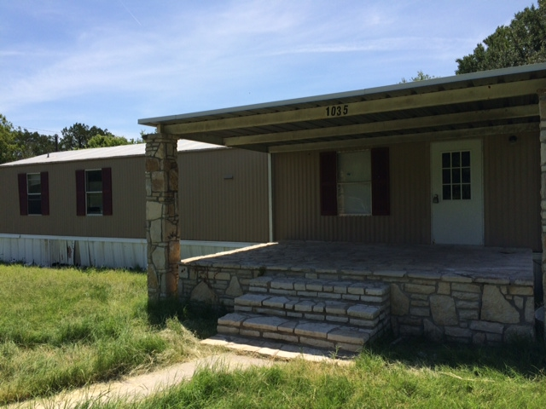
1035 Pawnee
Granbury, TX 76048
3 bedroom / 2 bathroom
Rented for $895 / month – 30% Gross Yield
3.3% Unemployment*
10.4% Below Poverty Line*
*zipskinny.com demographics

Slide 7
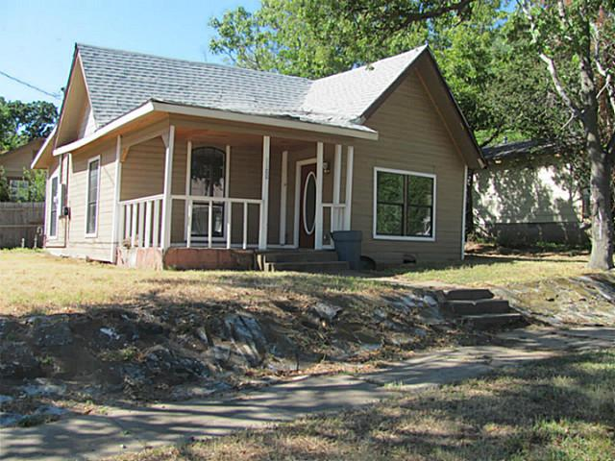
1100 Owings
Denison, TX 75020
2 bedroom / 1 bathroom
Rented for $650 / month – 30% gross yield
3.3% Unemployment*
12.6% Below Poverty Line*
*zipskinny.com demographics

Slide 8
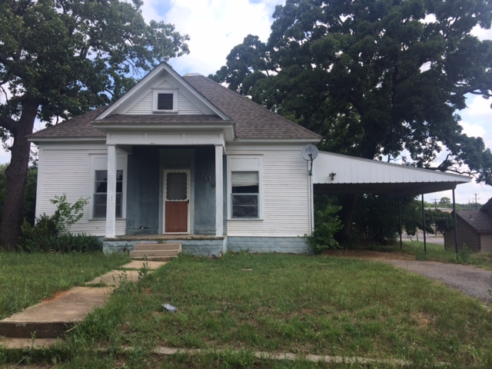
509 Rice
Denison, TX 75020
2 bedroom / 1 bathroom
Rented for $595 / month – 30% gross yield
3.3% Unemployment*
12.6% Below Poverty Line*
*zipskinny.com demographics

